Slide 1




Mini Project Presentation T.E. (AIML) Sem – Vl
Lokmanya Tilak College of Engineering, Navi Mumbai
Computer Science and Engineering
(Artificial Intelligence and Machine Learning)
2024-25 EVEN

Slide 2



Movie and Song Recommendation System
Group Members:
Riddhi Danej : (203)
Aditya Maurya : (222)
Sandesh Futane : (206)
Umair Mir : (220)
Project Guide:
Prof.Sheshmal Shingne

Slide 3


Presentation Outline
Abstract
Introduction
Literature Survey
Limitations of Existing System
Problem Statement
Objective
Scope
Flowchart
Experimental Setup
Implementation
Conclusion
References

Slide 4


Abstract
A Movie and Song Recommendation System is designed to suggest personalized content by analyzing user preferences, past interactions, and behaviour. It utilizes techniques such as collaborative filtering and content-based filtering to improve recommendation accuracy. By reducing search time and providing relevant recommendations, such systems improve engagement and satisfaction, making entertainment more enjoyable and accessible.

Slide 5


With the rise of digital entertainment, finding the right movies and songs can be overwhelming. A Movie and Song Recommendation System simplifies this by using AI and machine learning to suggest content. Platforms like Netflix and Spotify use these systems to enhance user experience by providing personalized recommendations, and entertainment more enjoyable. Chatbot integration for interactive recommendations. User preference-based filtering for accuracy. Enhances engagement with a seamless entertainment experience
Introduction

Slide 6
Literature Survey
Sr.No | Title of the paper with Author Names and Journal/conference Name | Year of publication | Paper Description | Research gaps
1. | Hybrid Song Recommendation System Based on User Behavior and Content Features Authors: Alex Johnson, Emily Davis Journal: Music and AI Innovations | 2024 | This research combines content-based filtering and deep learning to recommend songs based on audio features and user listening history. The system enhances recommendations by analyzing song tempo, genre, and lyrics. | The study does not include real-time feedback mechanisms to refine recommendations dynamically.
2. | AI-Powered Music Recommendation Using Emotion Detection Authors: David Wilson, Sophia Green Journal: AI and Multimedia Journal | 2023 | This system recommends songs based on real-time emotion detection using facial recognition and speech analysis. It enhances user experience by adapting to mood changes. | The approach relies on external devices like cameras and microphones, which raises privacy concerns.

Slide 7
Sr.No | Title of the paper with Author Names and Journal/conference Name | Year of publication | Paper Description | Research gaps
3. | Personalized Movie Recommendation Using Machine Learning Authors: John Doe, Jane Smith Journal: International Journal of AI Research | 2023 | This study uses collaborative filtering and deep learning techniques to recommend movies based on user preferences and ratings. The model improves accuracy by integrating sentiment analysis from user reviews. | The system focuses on textual sentiment but lacks real-time adaptation to changing user interests.
4. | Machine Learning-Based Movie Recommendation Using User Interaction Data Authors: Michael Lee, Sarah Brown Journal: Journal of Intelligent Systems | 2022 | This paper proposes a deep neural network model that analyzes user interactions, such as watch time and skipping behavior, to provide better movie recommendations. | The study does not incorporate external factors like social media trends or friend recommendations.

Slide 8

Limitation of Exisiting System
1. Cold Start Problem
Struggles to recommend content for new users or items due to a lack of data.
2. Privacy Concerns
Collecting user data raises ethical and security issues.
3. Lack of Real-Time Updates
Struggles to adapt quickly to changing user preferences.
4. Bias in Recommendations
Popular content is favoured, limiting exposure to new or niche items.
5. Ignoring Context
Does not always consider mood, location, or time when recommending content.
6. Limited Interaction
Most platforms do not provide an AI chatbot for real-time suggestions.

Slide 9


Problem Statement
Finding relevant movies and songs is challenging due to the vast amount of content available on streaming platforms.
Traditional search methods are inefficient and do not personalize recommendations based on user preferences.
Existing recommendation systems face issues like the cold start problem, where new users or items lack sufficient data for accurate suggestions.
Over-specialization leads to repetitive recommendations, limiting content diversity and discovery.
Bias in recommendations favours popular content, making it difficult for users to explore new or niche options.

Slide 10

Objectives
Objective
Reduce Bias in Recommendations
Maintain Privacy and Data security
Incorporate Context Aware suggestions
Improve User engagement
Address Cold Start Problem
Support multi language content

Slide 11

Scopes
Integration with Streaming Platforms – Can be deployed on OTT platforms like Netflix, Prime Video, or Disney+.
Real-Time Recommendations – Adapting to user behaviour in real-time for dynamic suggestions.
Multi-Language Support – Expanding recommendations to non-English movies based on subtitles and reviews.
User Data Analysis – Tracks and learns from user interactions to refine future recommendations
This system aims to revolutionize the movie recommendation process by making it smarter, more personalized, and highly efficient for users.

Slide 12
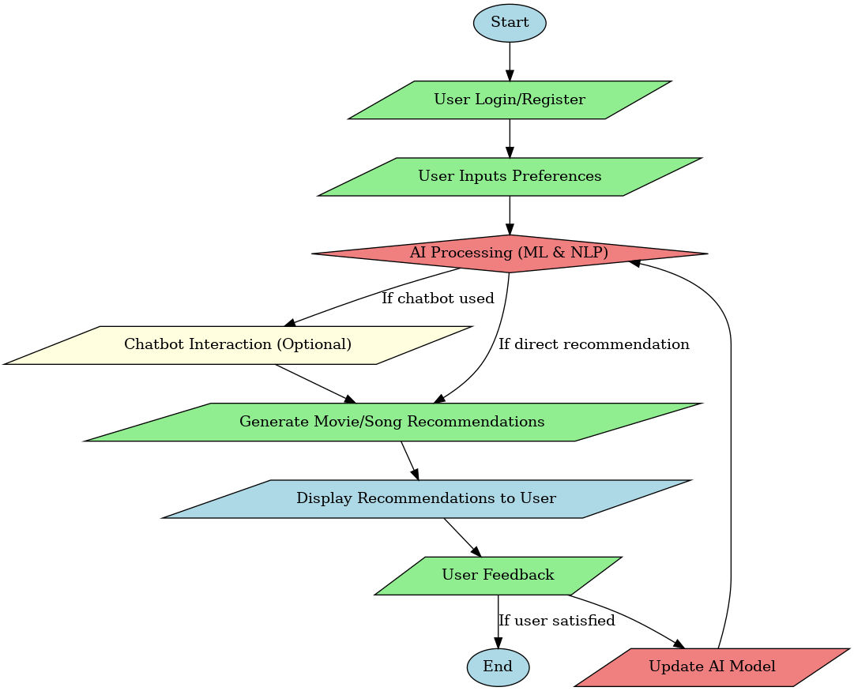
Flowchart

Slide 13

Experimental Setup
Hardware: PC/Laptop with intel core i5, 8 GB RAM, 256 GD SSD, 1080p monitor.
Software:
Programming Language: Python
Framework: Flask (for backend development)
Machine Learning Libraries: Scikit-learn, Pandas, NumPy
Chatbot Integration: Custom NLP Model, Chatgpt Api
Development Tools: VS Code.
Database: SQLite (for storing user preferences)
Deployment: Flask Server / Cloud Platforms Streamlit

Slide 14
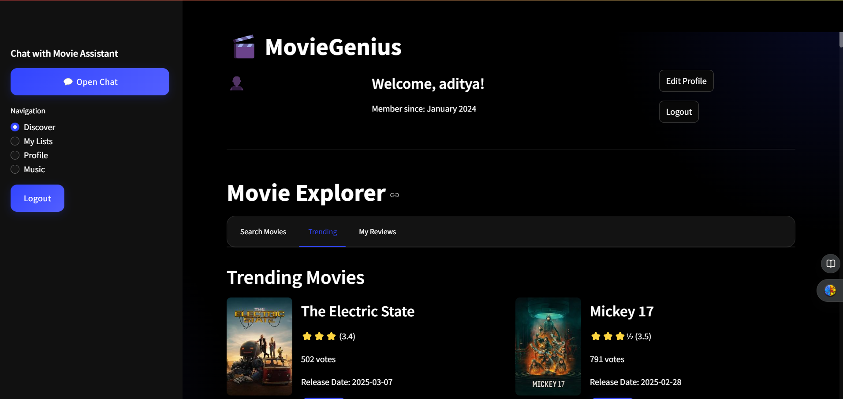
Implementation

Slide 15
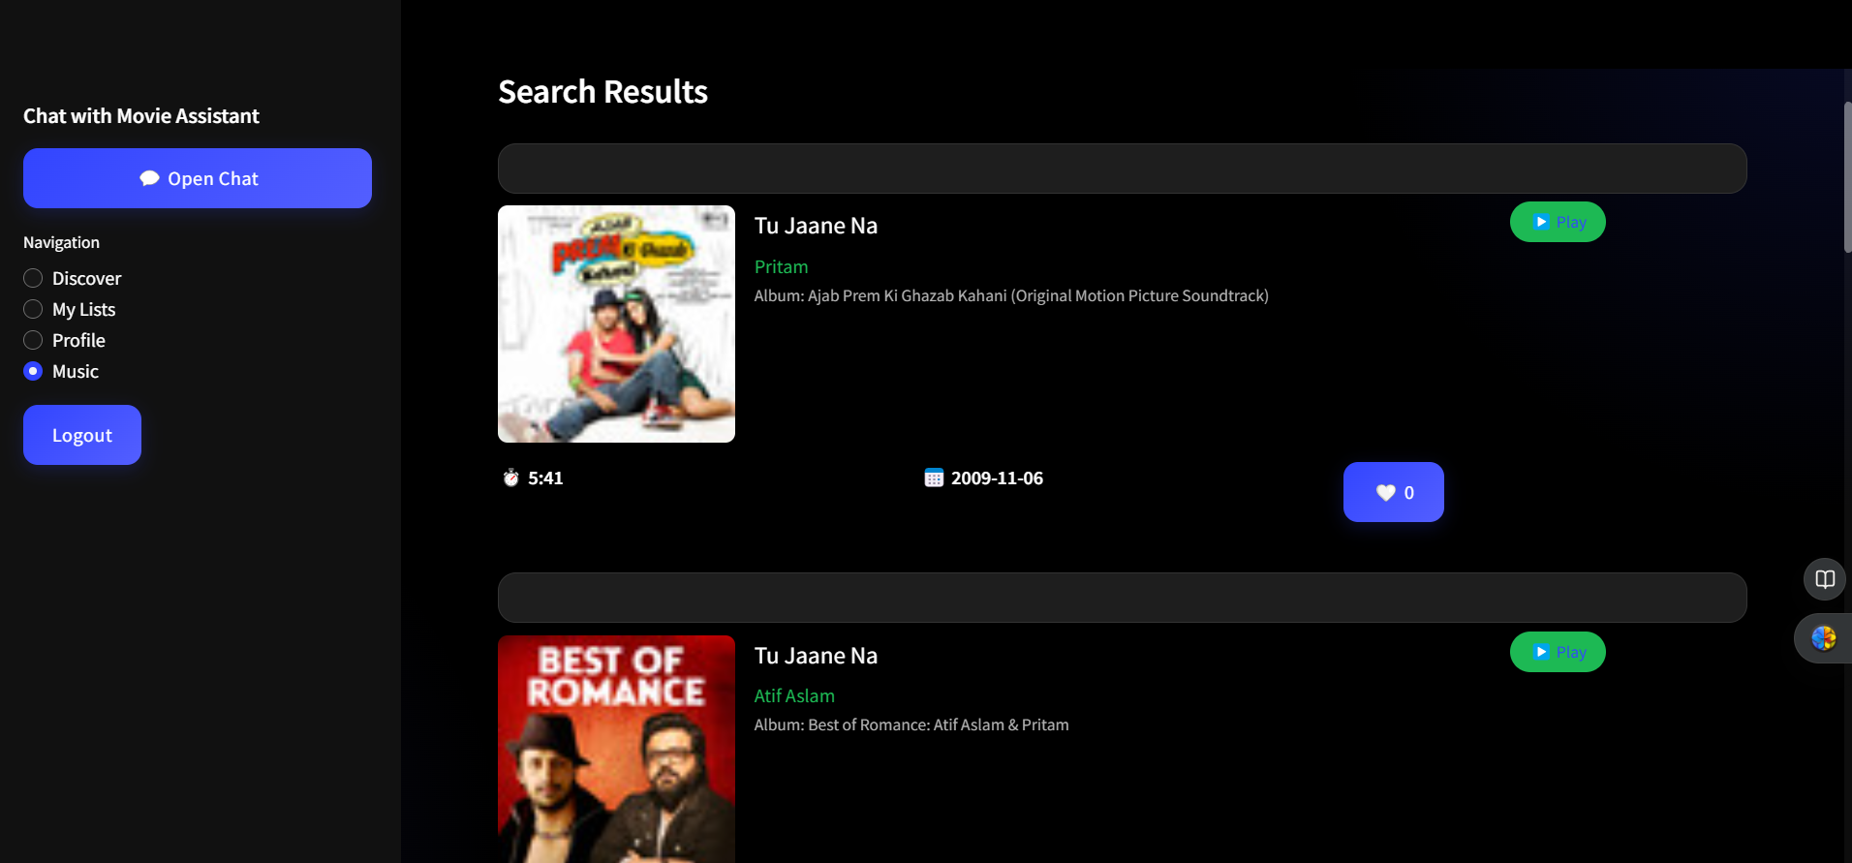

Slide 16
Conclusion
A Movie and Song Recommendation System helps users find content easily by analyzing their preferences. It improves user experience by reducing search time and offering personalized suggestions. While challenges like cold start, bias, and privacy concerns exist, advanced AI and real-time updates can make recommendations more accurate. A well-designed system enhances entertainment accessibility and user satisfaction.

Slide 17
References
Patel, R., & Kumar, S. (2022). Content-based vs. collaborative filtering: A comparative study in music recommendation. International Journal of Artificial Intelligence & Music, 18(3), 45–60.
Smith, J., & Lee, K. (2023). Enhancing movie recommendation systems using deep learning and collaborative filtering. IEEE Transactions on Multimedia, 25, 1234–1245.
Wang, L., & Chen, X. (2024). Personalized song recommendation using hybrid machine learning approaches. Journal of Music Information Retrieval, 12, 567–580.
OpenAI. (2024). Leveraging GPT for AI-powered movie and song recommendations. OpenAI.com.

Slide 18

Thank You!

